Slide 1
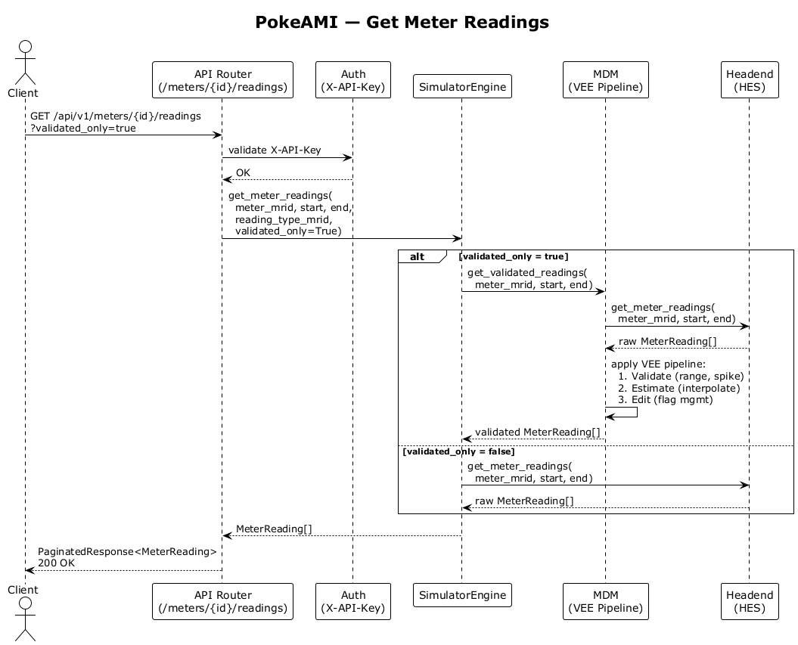
PokeAMI — Get Meter Readings
API Router (/meters/{id}/readings)
Auth (X-API-Key)
SimulatorEngine
MDM (VEE Pipeline)
Headend (HES)
GET /api/v1/meters/{id}/readings ?validated_only=true
validate X-API-Key
OK
get_meter_readings( meter_mrid, start, end, reading_type_mrid, validated_only=True)
alt
[validated_only = true]
get_validated_readings( meter_mrid, start, end)
get_meter_readings( meter_mrid, start, end)
raw MeterReading[]
apply VEE pipeline: 1. Validate (range, spike) 2. Estimate (interpolate) 3. Edit (flag mgmt)
validated MeterReading[]
[validated_only = false]
get_meter_readings( meter_mrid, start, end)
raw MeterReading[]
MeterReading[]
PaginatedResponse<MeterReading> 200 OK
API Router (/meters/{id}/readings)
Auth (X-API-Key)
SimulatorEngine
MDM (VEE Pipeline)
Headend (HES)

